Slide 1
My Journey with Operations Research
Professor
Özgür Özlük

Slide 2
OUTLINE
Education: Traveling Circus Problem
Industry Job #1 : Crew Recovery for Airlines
Industry Job #2 : Pricing and Revenue Management
Academician revisits Industry: Supply Chain Management
NOW: O.R. meets Big Data

Slide 3
What is Operations Research?
Making decisions when constrained
An elevator pitch:
How to optimize a bank branch services
Notes:
Good to have more than one way to explain yourself

Slide 4
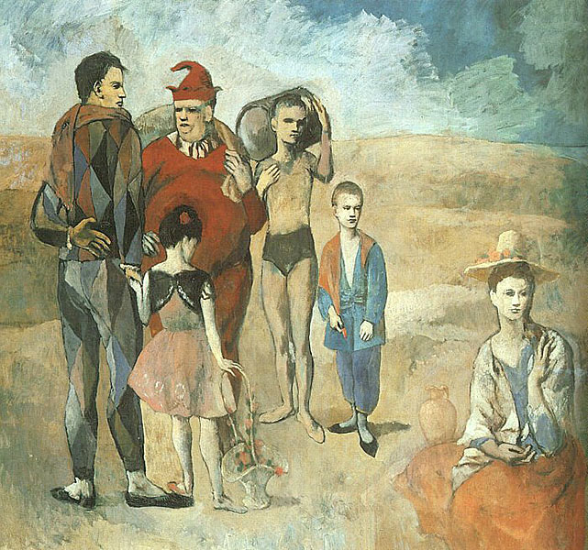
Traveling Circus Problem (TCP)
Notes:
How did I choose this problem?

Slide 5
PhD

Slide 6
Traveling Salesman Problem
Notes:
Hamiltonian paths

Slide 7
Traveling Salesman Problem
n cities → (n-1)! / 2
Largest instance: 85,900 nodes
NP-Hard
Notes:
Drilling printed circuit boards
Order picking in warehouses

Slide 8
p-median problem

Slide 9
p-median problem
Notes:
School districting
Warehouse location

Slide 10
Traveling Circus Problem (TCP)
Notes:
Health care distribution
Bi-level hierarchical transportation networks
Solved the problem faster – IP vs LP
Using C code

Slide 11
TCP: Lessons Learned
Finding a job after a theoretical PhD is hard!
Theoretical research is a lonely process!
Programming/Data Manipulation is fun!
Notes:
One academic job
Two industry jobs
OPT

Slide 12
Job #1: Caleb Technologies, TX

Slide 13
Crew Recovery Problem (CRP)
In response to disruptions that result in crew being unable to fly their assigned flights,
Recovery of active crew back onto their original schedules and,
Assignment of additional reserve crew to new schedules
Notes:
Manually solved Continental vs Northwest

Slide 14
Crew Recovery Problem
ORIGINAL PAIRINGS
PHX: 0745 EWR: 1415
EWR: 1700
RDU: 1900
RDU: 1945 EWR: 2100
IAH: 1030 RDU: 1400
RDU: 1630
EWR: 1815
EWR: 1945
PVD: 2045
PVD: 1330+
EWR:1430+
EWR:1600+
SEA: 1900+
SEA: 2000+
IAH: 0200+
Notes:
Pink has to be at EWR at the end of the day
Blue has to be at IAH at the end of day 2

Slide 15
Crew Recovery Problem
ORIGINAL PAIRINGS
PHX: 0745 EWR: 1415
EWR: 1700
RDU: 1900
EWR: 1700
RDU: 1900
RDU: 1945 EWR: 2100
IAH: 1030 RDU: 1400
RDU: 1630
EWR: 1815
RDU: 1630
EWR: 1815
EWR: 1945
PVD: 2045
PVD: 1330+
EWR:1430+
EWR:1600+
SEA: 1900+
SEA: 2000+
IAH: 0200+
Notes:
Reassign crews from one flight to another,
Deadhead crews to cover a flight or return back to base,
Assign crews additional duty periods,
Using reserve crews to cover flights left uncovered

Slide 16
Crew Recovery Problem
ORIGINAL PAIRINGS
PHX: 0745 EWR: 1415
RDU: 1945 EWR: 2100
IAH: 1030 RDU: 1400
EWR: 1945
PVD: 2045
PVD: 1330+
EWR:1430+
EWR:1600+
SEA: 1900+
SEA: 2000+
IAH: 0200+

Slide 17
Crew Recovery Problem
ORIGINAL PAIRINGS
PHX: 0745 EWR: 1415
RDU: 1945 EWR: 2100
IAH: 1030 RDU: 1400
EWR: 1945
PVD: 2045
PVD: 1330+
EWR:1430+
EWR:1600+
SEA: 1900+
SEA: 2000+
IAH: 0200+
NEW PAIRINGS
RDU: 1945 EWR: 2100
EWR: 1945
PVD: 2045
PVD: 1330+
EWR:1430+

Slide 18
Crew Recovery Problem (CRP)
ORIGINAL PAIRINGS
PHX: 0745 EWR: 1415
EWR: 1700
RDU: 1900
RDU: 1945 EWR: 2100
IAH: 1030 RDU: 1400
RDU: 1630
EWR: 1815
EWR: 1945
PVD: 2045
PVD: 1330+
EWR:1430+
EWR:1600+
SEA: 1900+
SEA: 2000+
IAH: 0200+
NEW PAIRINGS
PHX: 0745 EWR: 1415
IAH: 1030 RDU: 1400
RDU: 1945 EWR: 2100
EWR:1600+
SEA: 1900+
SEA: 2000+
IAH: 0200+
EWR: 1945
PVD: 2045
PVD: 1330+
EWR:1430+

Slide 19
Crew Recovery Problem: Steps
What do you do now?
How would we help you?
Prepare solution(s)
Implement solution(s)
Notes:
Prototyped in Excel
Tried optimization in CPLEX

Slide 20
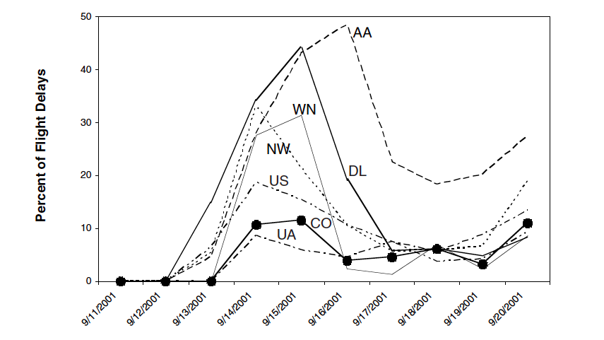
Crew Recovery Problem
Notes:
Save $30 millions in estimated savings
1600 pairs reassigned 17 min

Slide 21
CRP: Lessons Learned
Listen to the people who have been doing the job before you arrived!
Optimal solution is not always the best!
Learn how to make a criticism sandwich…

Slide 22
Job#2: Talus Solutions, CA

Slide 23
Pricing & Revenue Mgmt. (PRM)
A semi-conductor company selling to different types of businesses at various price points
Can we identify clusters of businesses with similar price-sensitivities for a uniform pricing strategy?
Notes:
Custom solution to software move

Slide 24
Revenue Management and Pricing
Transactions
Database
Normalized Sales Forecast
Sales Forecast
Price Optimizer
Cost Model
Price Sensitivity Model
Supply Model
Lost Sales Model
Strategic
Goals
Notes:
Prototyped in Excel
Developed in SAS
Coded in C++

Slide 25
PRM: Lessons Learned
Data is rarely clean and in one place!
R² of 5% is not necessarily bad.
Sometimes, simple trumps sophisticated!

Slide 26
Job#3: SFSU, College of Business
Notes:
Love teaching
Worked on different topics,
google model and spreadsheet engineering, call centers
Wanted more applied problems

Slide 27
SCM: High End
Strategic Sourcing vendor-shows:
a venue where vendors who have been awarded
either University of California (UC) system-wide or UCSF campus agreement
to showcase their value directly to researchers and departmental buyers.
Notes:
A former graduate student

Slide 28






SCM: High End
Limit number of vendors per show
Limit number of shows per vendor
Diversity within a show
Diversity w.r.t. time
Notes:
Simple matching problem
With focus on the weights
A combo of incentives vs vendor preferences
GAMS solver

Slide 29
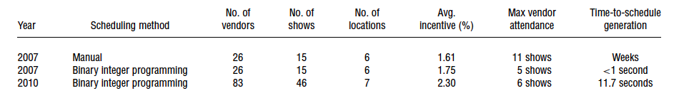
SCM: High End

Slide 30
SCM: Low End
A manufacturing company
Monthly Sales: 10,000 units
Inventory Level: 45,000 units
Production Lead Time:
6 weeks

Slide 31
SCM: Low End
Causes
Too many SKUs with different levels of variability
Erratic behavior from the sales force
Archaic planning system
Hide behind inventory
Solution
Create a SKU level forecast
Use it to plan production
Notes:
Excel

Slide 32
SCM: Lessons Learned
Having top level support within the organization is important!
Badly organized data → Wasted time/money
Excel is the always second best way to do anything! Sometimes it is the best way!!

Slide 33
O.R. is now Data Analytics
Find Data
Grab What You Need
Preprocess / Clean Data
Slice/Dice
Fit Model
Analyze
Present/ Implement

